Slide 1

Azure AZ-900 Resources
Daniel Rey
MCT/MVP
Microsoft 365 Apps and Services

Slide 2
Links (Not everything is Azure-related, but tech-related)
https://docs.microsoft.com/en-us/certifications/resources/dp-900-sample-questions?azure-portal=true
https://docs.microsoft.com/en-us/certifications/resources/az-900-sample-questions and AI-900: Microsoft Azure AI Fundamentals Sample Questions | Microsoft Docs
https://azure.microsoft.com/en-us/products/azure-modular-datacenter/#features
Have I Been Pwned | Microsoft Docs
https://informationisbeautiful.net/visualizations/worlds-biggest-data-breaches-hacks/
https://docs.microsoft.com/en-us/events/ignite-mar-2021/azure/sessions/od343/
https://www.linkedin.com/video/golive/now/ - setup LinkedIn Live (Azure location is a choice from this page)
https://docs.microsoft.com/en-us/office/developer-program/microsoft-365-developer-program-faq
https://www.rupeshtiwari.com/azure-update-domain-vs-fault-domain/
https://azure.microsoft.com/en-us/support/legal/sla/virtual-machines/v1_9/
https://support.microsoft.com/en-us/office/what-does-it-mean-when-your-onedrive-account-is-frozen-5e76147b-b7d5-4bcb-ba28-b91e3eb636b6
https://docs.microsoft.com/en-us/azure/active-directory/roles/security-emergency-access
The whole HP wolf security hacker man saga - YouTube
https://github.com/stilldrey (this will be up there)

Slide 3
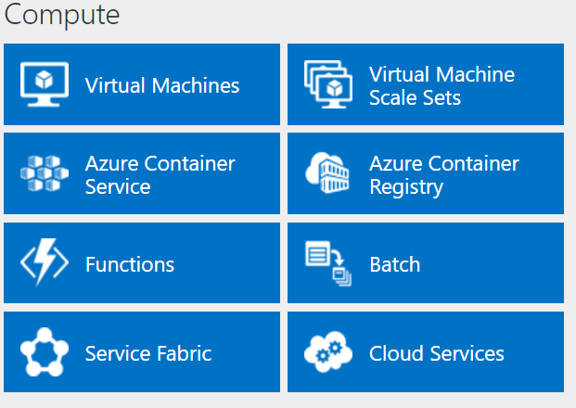
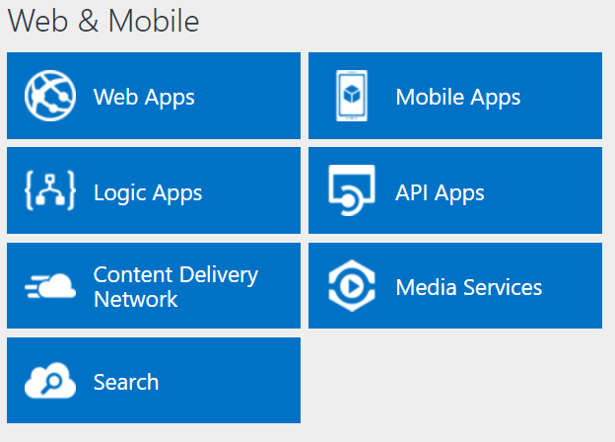
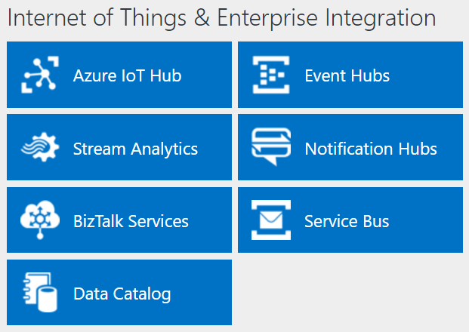
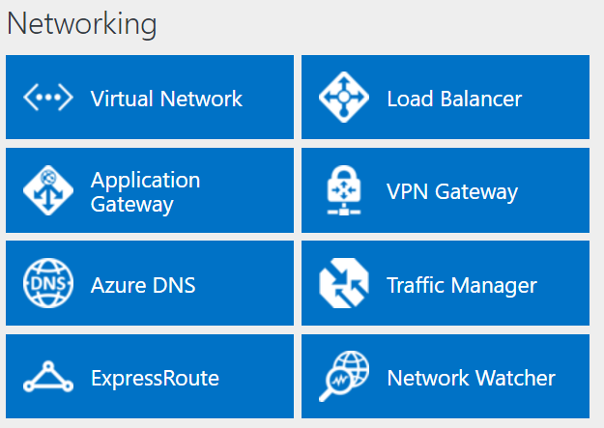
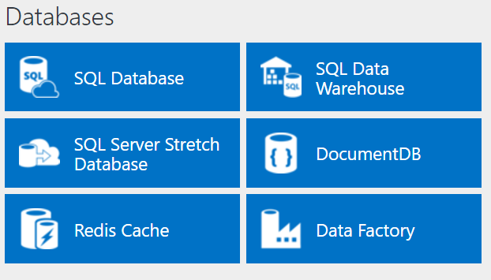
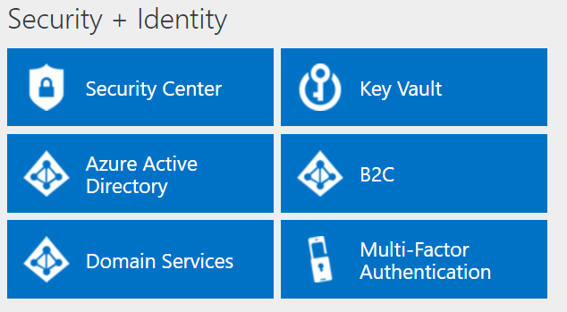
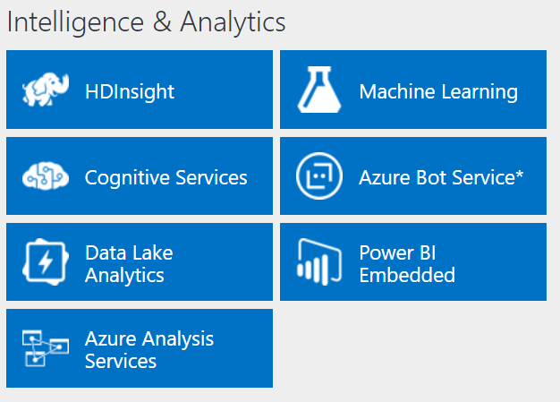
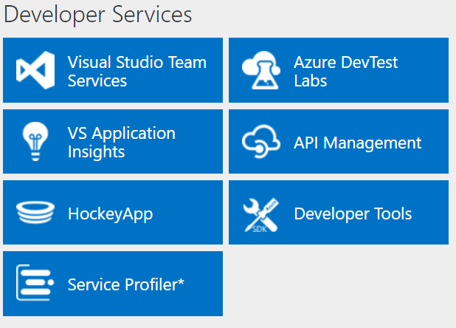
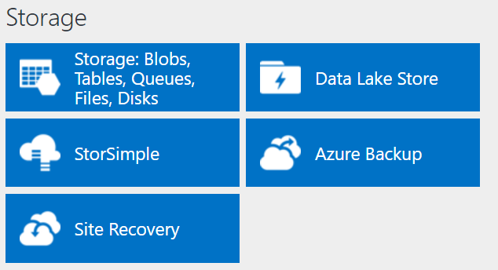
http://azureplatform.azurewebsites.net/
As of 2017
Directory of Azure Cloud Services | Microsoft Azure current
* Preview Services
Notes:
Preview Version 1.7 (2017-04-20)
azure platform site:azurewebsites.net - Search (bing.com)
Directory of Azure Cloud Services | Microsoft Azure

Slide 4
More Resources
Project Natick Project Natick Phase 2 (microsoft.com)
Azure Modular Datacenter | Microsoft Azure
The Azure Infrastructure Architect Map - Microsoft Tech Community
Azure Products by Region | Microsoft Azure
List of Azure services the Azure CLI can manage | Microsoft Docs
History of Microsoft Azure

Slide 5
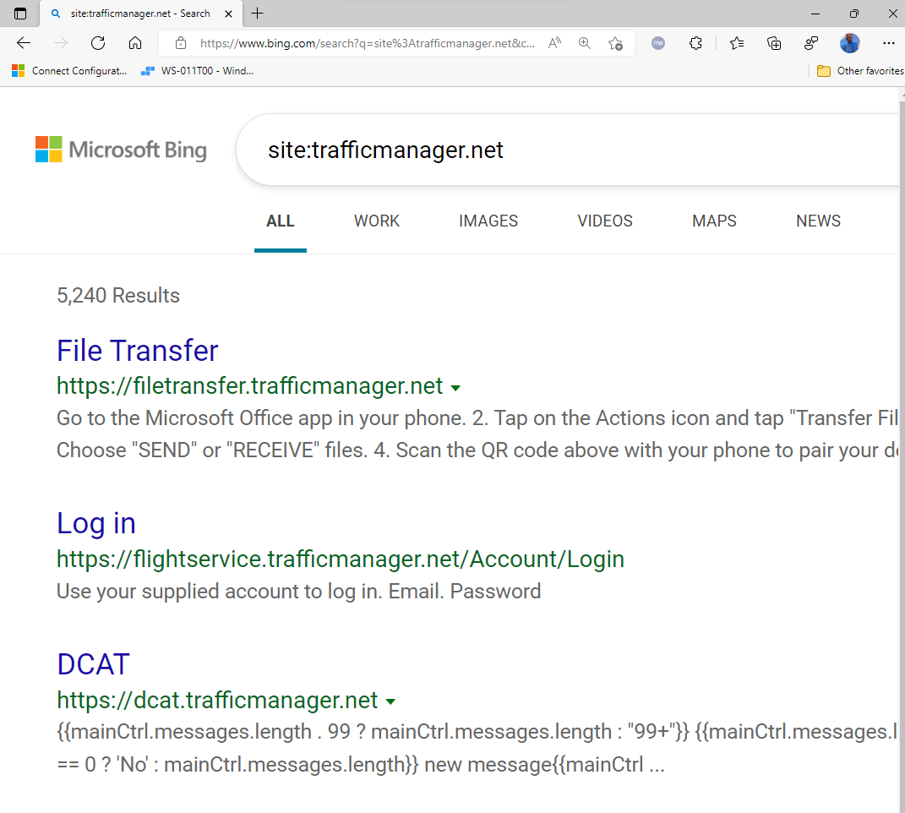
TIP: List all the trafficmanager.net sites (global)

Slide 6
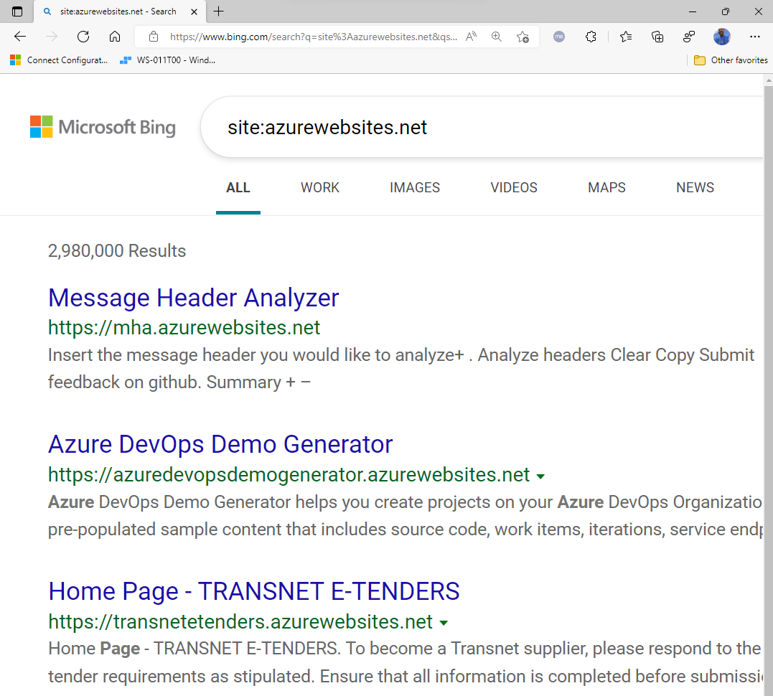
Tip: site:azurewebsites.net search in bing or google

Slide 7
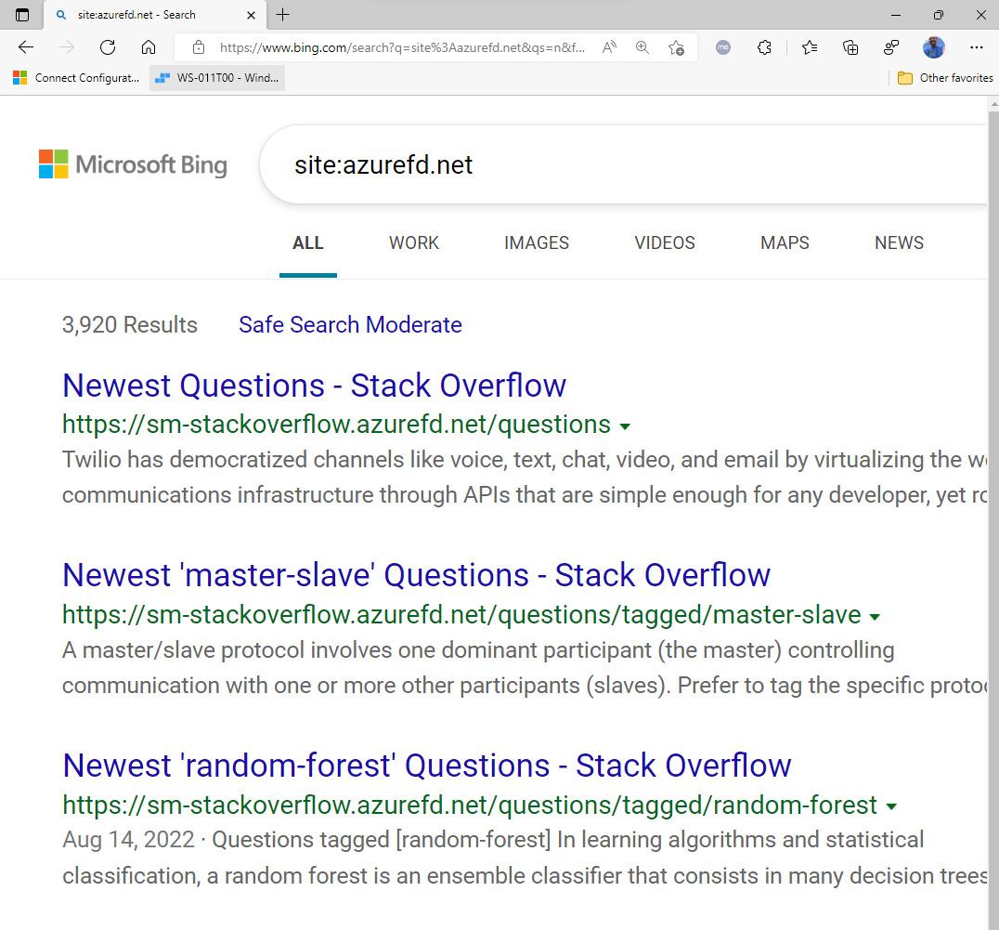
Same tip with azurefd.net (azure front door websites)
LinkedIn is moving to Microsoft Azure three years after acquisition (cnbc.com)
Accelerating the LinkedIn Experience with Azure Front Door | LinkedIn Engineering

Slide 8
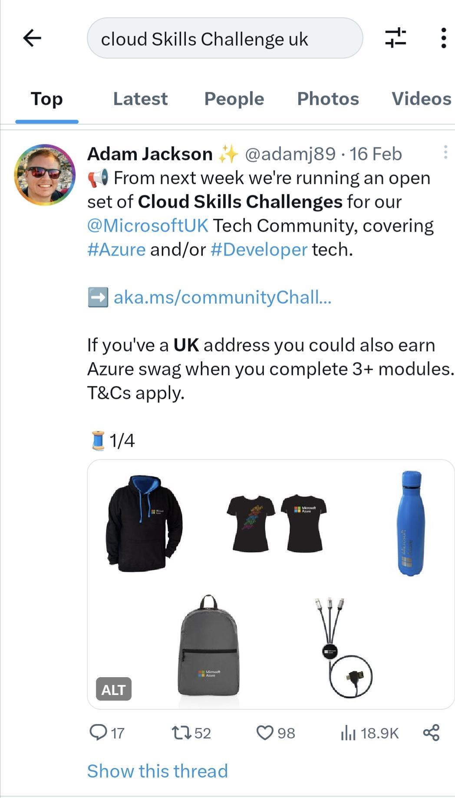
March 2023 update!
Cloud Skills Challenge (UK residents have swag available!!!) https://twitter.com/adamj89/status/1626155400713191425?t=2rVyK6L7J_DE_o3raoVu9g&s=19
https://youtu.be/tQp1YkB2Tgs John Savills
Technical Training

Slide 9
More to come!

